Slide 1
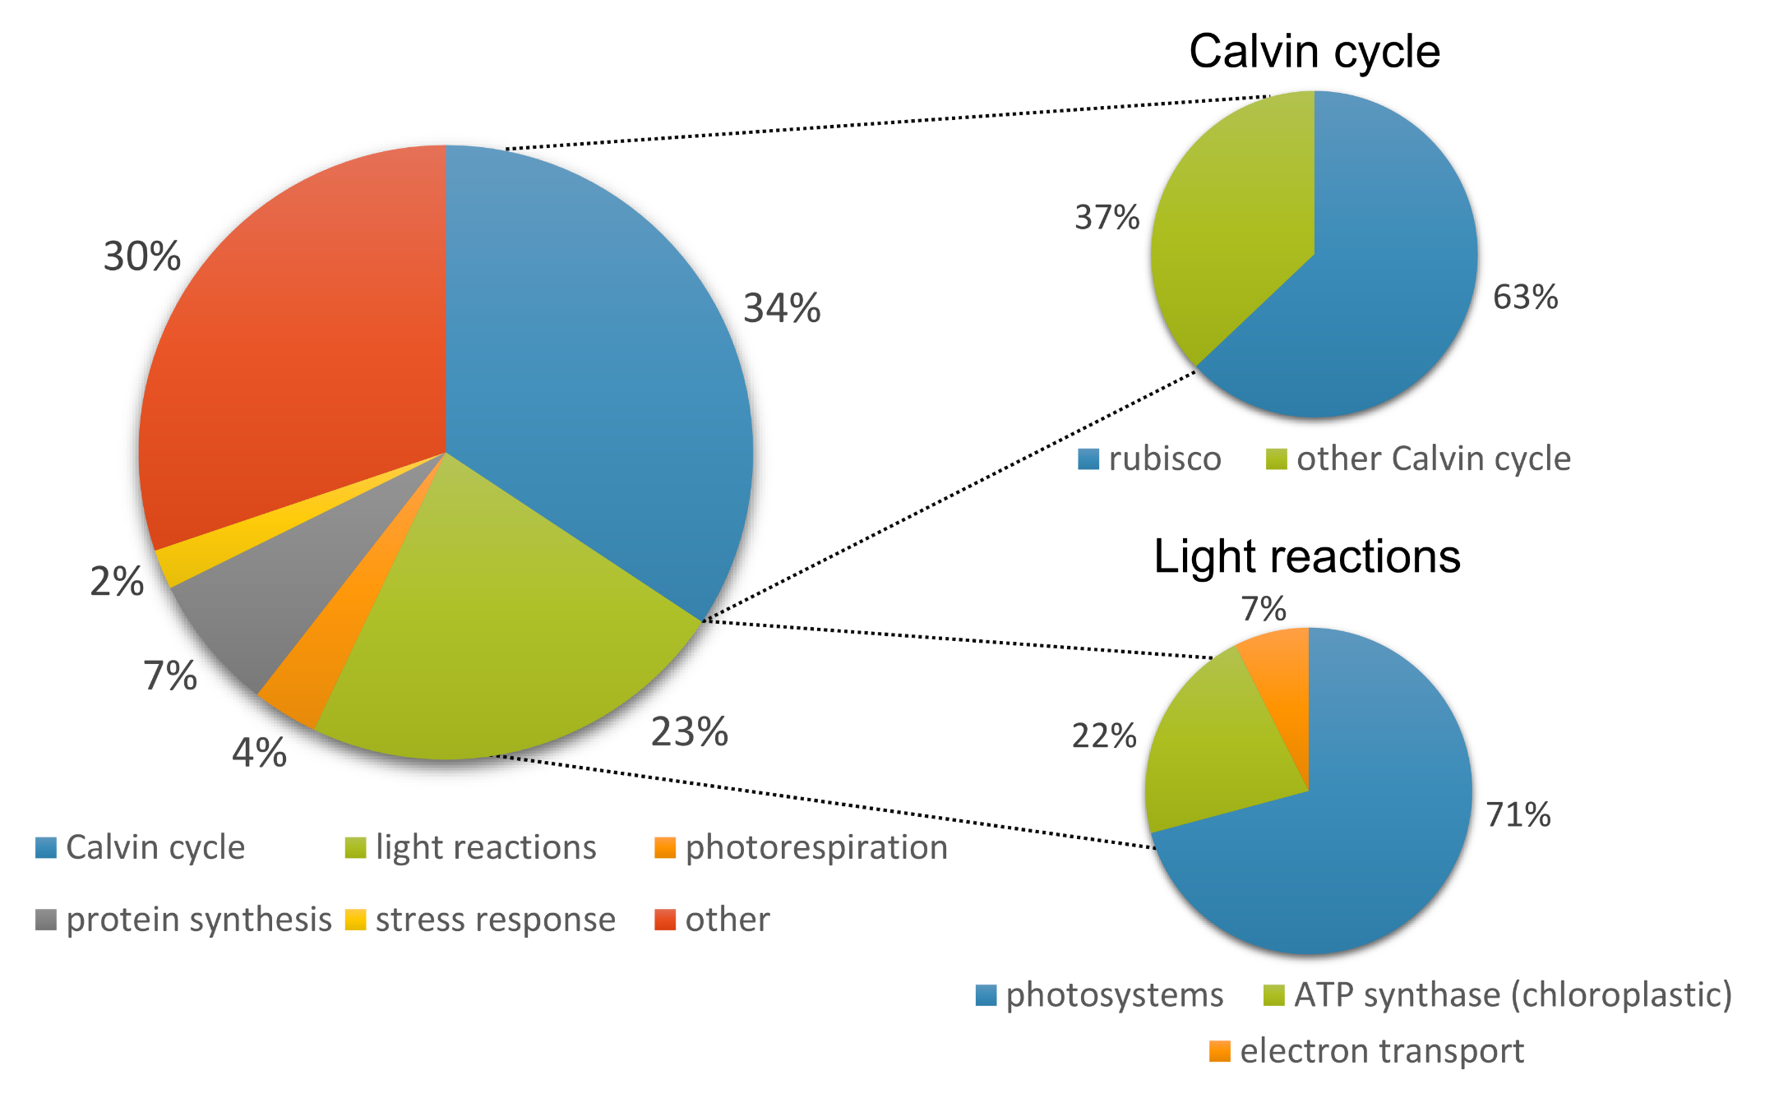
What’s in a leaf?
Protein content ranges between 2 and 27 % of leaf mass (mean 11%, SD 4%)
Notes:
Around 60% of the protein in our euc leaves was accounted for by photosynthesis proteins.
The mean abundances of the different functional categories shift around – as different samples have different proportions of protein within a given functional category at a given rank.
There are some gaps in the data here because of the cumulative summing code I used – it finds the average proportion of total protein for a given rank, and if there aren’t any proteins from that rank for a particular functional category then there’s a gap. Or just a point if there was just one sample with a protein at that rank.
The categories that have super abundant proteins – that would be Rubisco in the Calvin cycle and ATP synthase – start off being the most abundant but are gradually replaced as we increase the number of proteins.

Slide 2
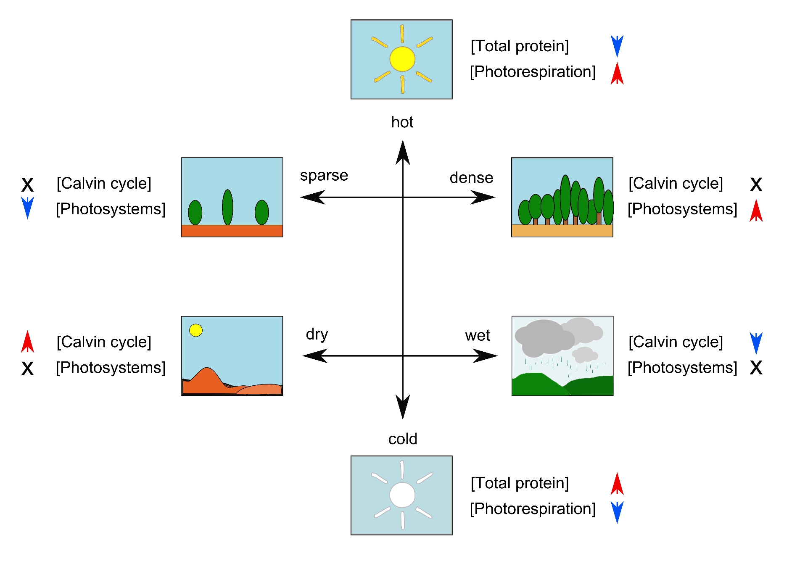
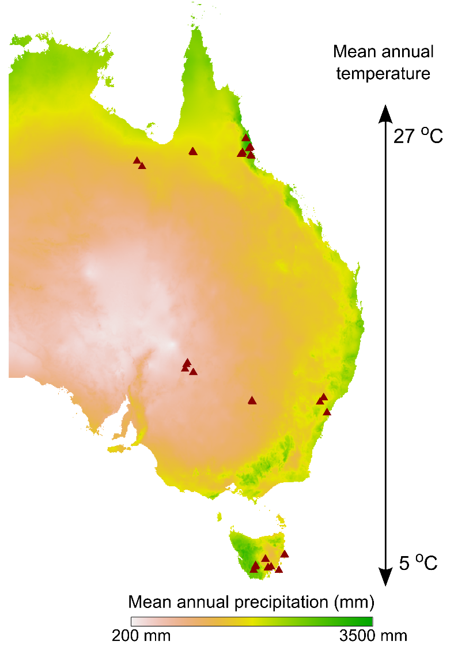
Environmental trends in leaf protein abundance
Co-ordination hypothesis: leaves should optimise protein allocation so that photosynthesis is co-limited by light capture and carboxylation capacity

Slide 3
Leaf protein content is greater at lower temperatures
p < 0.001, R² = 0.49, 85 % decline
p = 0.18
Leaf protein content varies 2.7-fold, between 17873 and 47639 mg / mm² (mean = 29007, SD = 6550)

Slide 4


Leaf protein content is greater at lower temperatures
p < 0.001, R² = 0.49, 85 % decline
p = 0.18
Leaf protein content varies 2.7-fold, between 17873 and 47639 mg / mm² (mean = 29007, SD = 6550)

Slide 5
Photorespiration proteins are not more abundant at higher temperatures
p < 0.001, R² = 0.49, 85 % decline
Photorespiration protein proportional abundance varies 2.5-fold, between 0.09 and 0.23 (mean = 0.16, SD = 0.03)

Slide 6
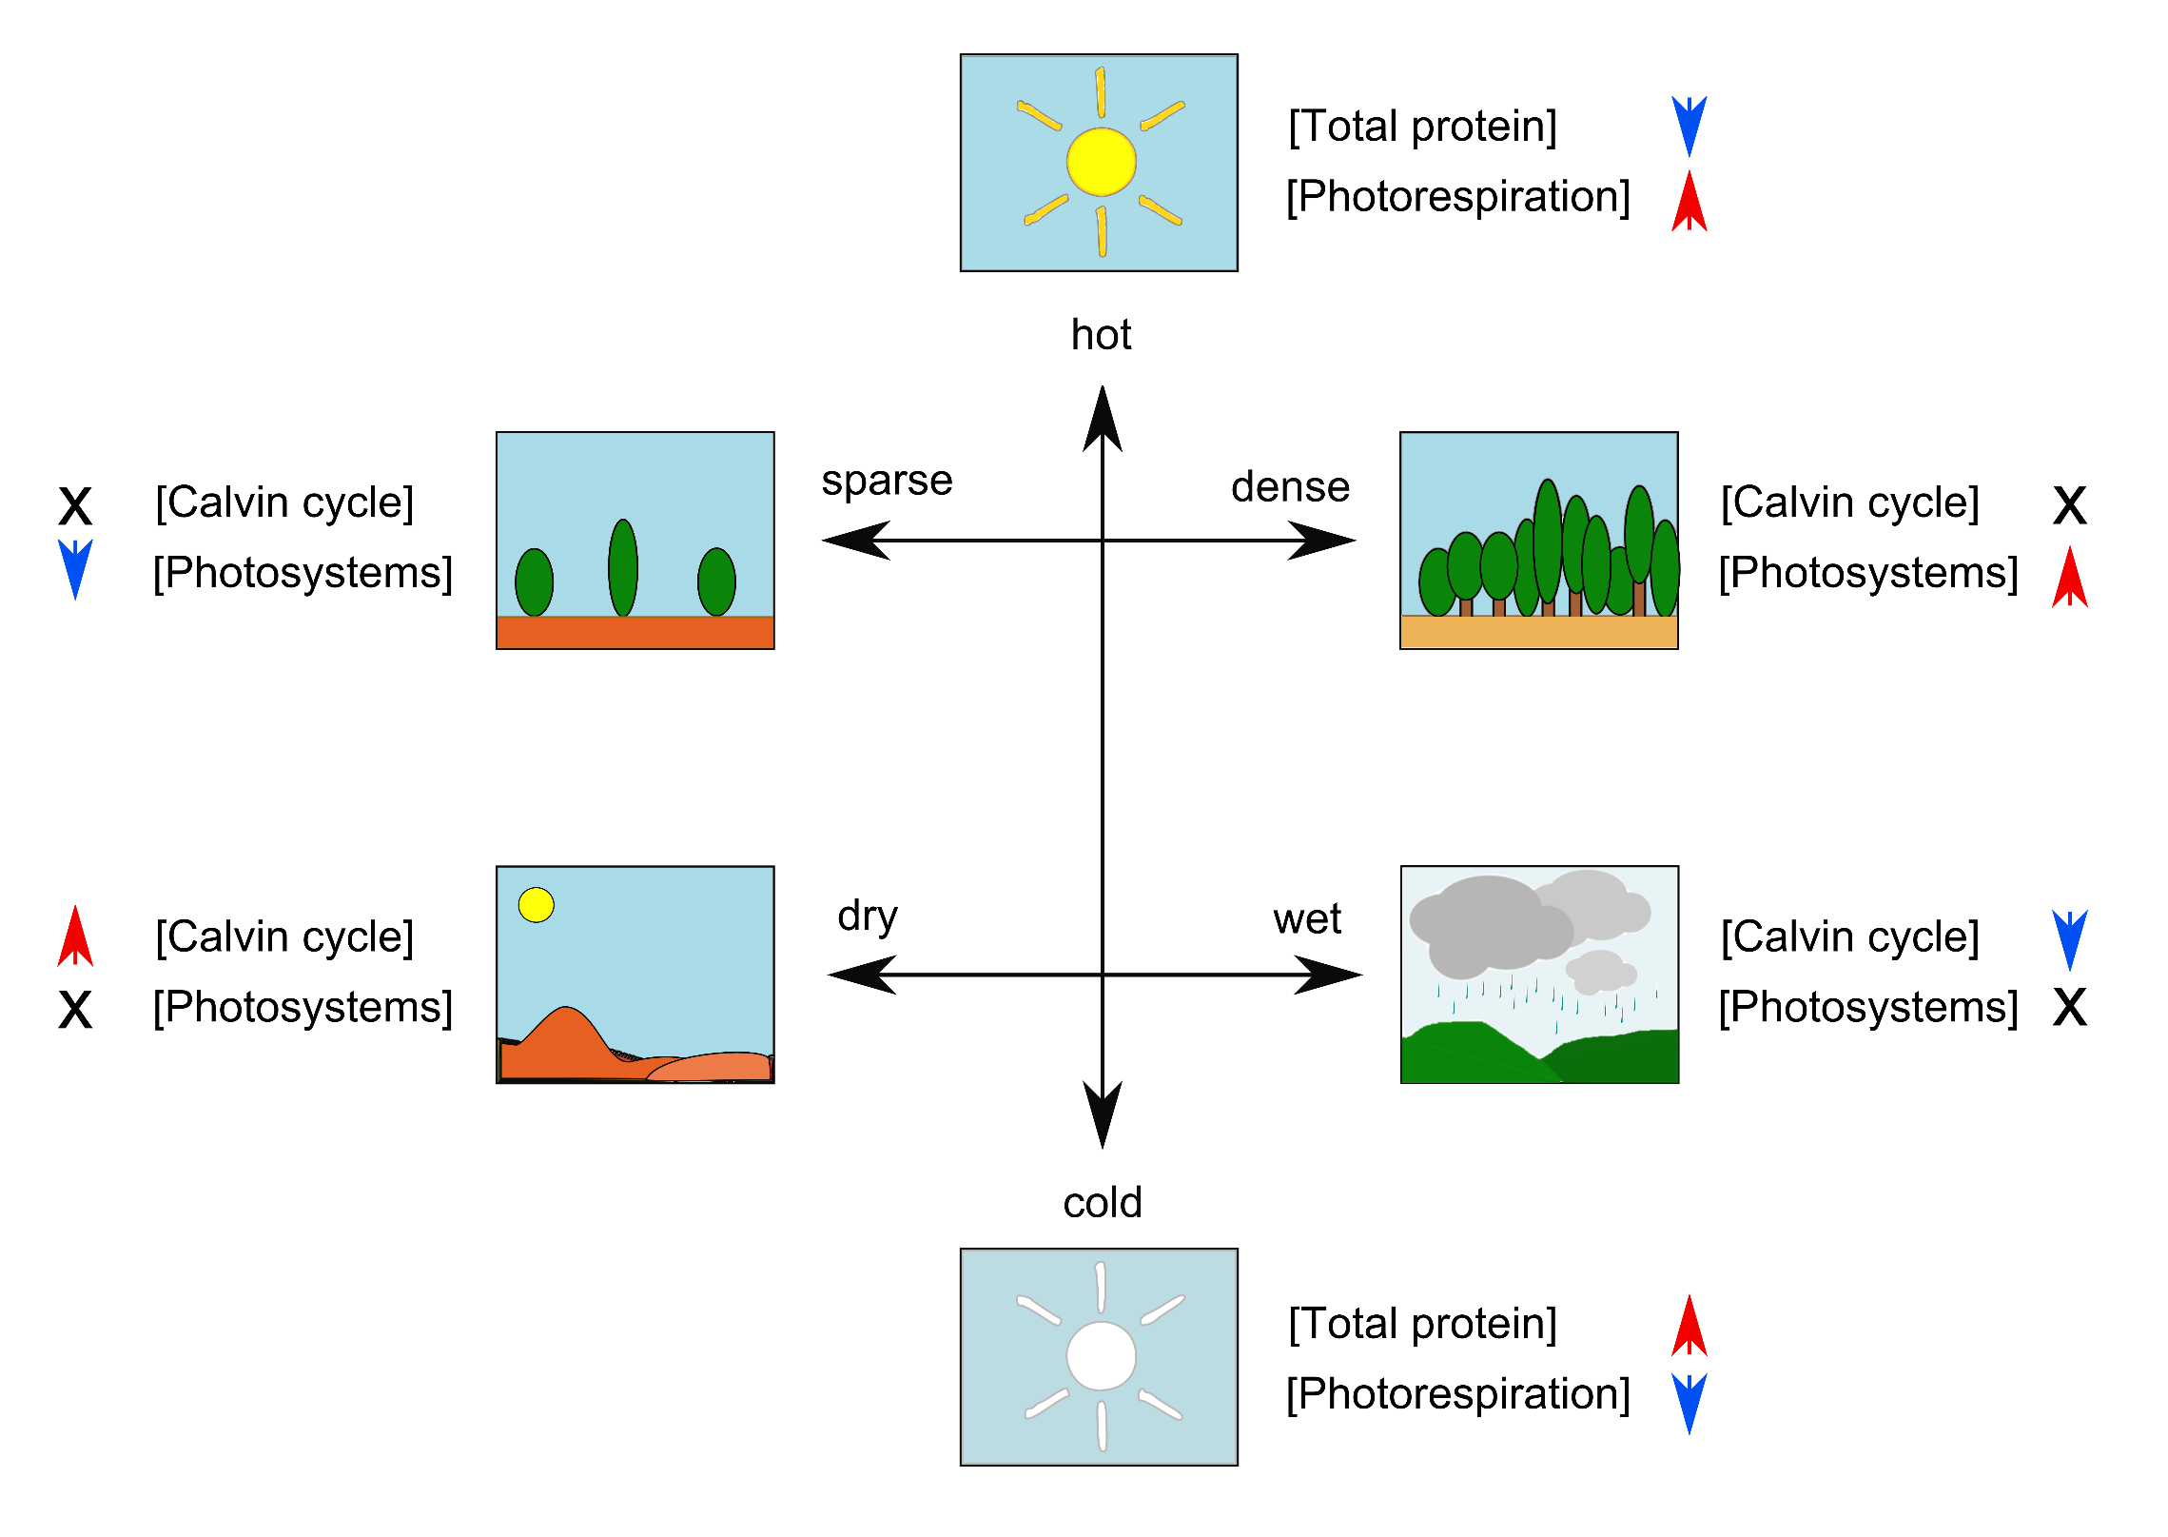

Slide 7
Allocation to photosystems is greater in low light
p < 0.001, R² = 0.43, 54 % decline
p < 0.001, R² = 0.37, 42 % decline
Photosystem protein proportional abundance varies 2.5-fold, between 0.09 and 0.23 (mean = 0.16, SD = 0.03)
Notes:
Disentangling precip effect – if you look at precip over just the last year, there’s a much weaker correlation. Could mean that we’re really interested in time averaged effect on vegetation structure and light evnrio

Slide 8
Allocation to photosystems is greater in low light
p < 0.001, R² = 0.43, 54 % decline
p < 0.001, R² = 0.37, 42 % decline
Photosystem protein proportional abundance varies 2.5-fold, between 0.09 and 0.23 (mean = 0.16, SD = 0.03)
Notes:
Disentangling precip effect – if you look at precip over just the last year, there’s a much weaker correlation. Could mean that we’re really interested in time averaged effect on vegetation structure and light evnrio

Slide 10
Trends in proportional abundance of Calvin cycle proteins
p = 0.19
p =0.02, R² = 0.16, 8 % increase
p = 0.07
Calvin cycle protein proportional abundance varies 1.3-fold, between 0.29 and 0.38 (mean 0.339, SD = 0.023)

Slide 11
Trends in proportional abundance of Calvin cycle proteins
p = 0.19
p =0.02, R² = 0.16, 8 % increase
p = 0.07
Calvin cycle protein proportional abundance varies 1.3-fold, between 0.29 and 0.38 (mean 0.339, SD = 0.023)

Slide 12
Variation in allocation to photosystems vs Calvin cycle proteins
r = 0.83
r = 0.94

Slide 13
Expected trends

Slide 14
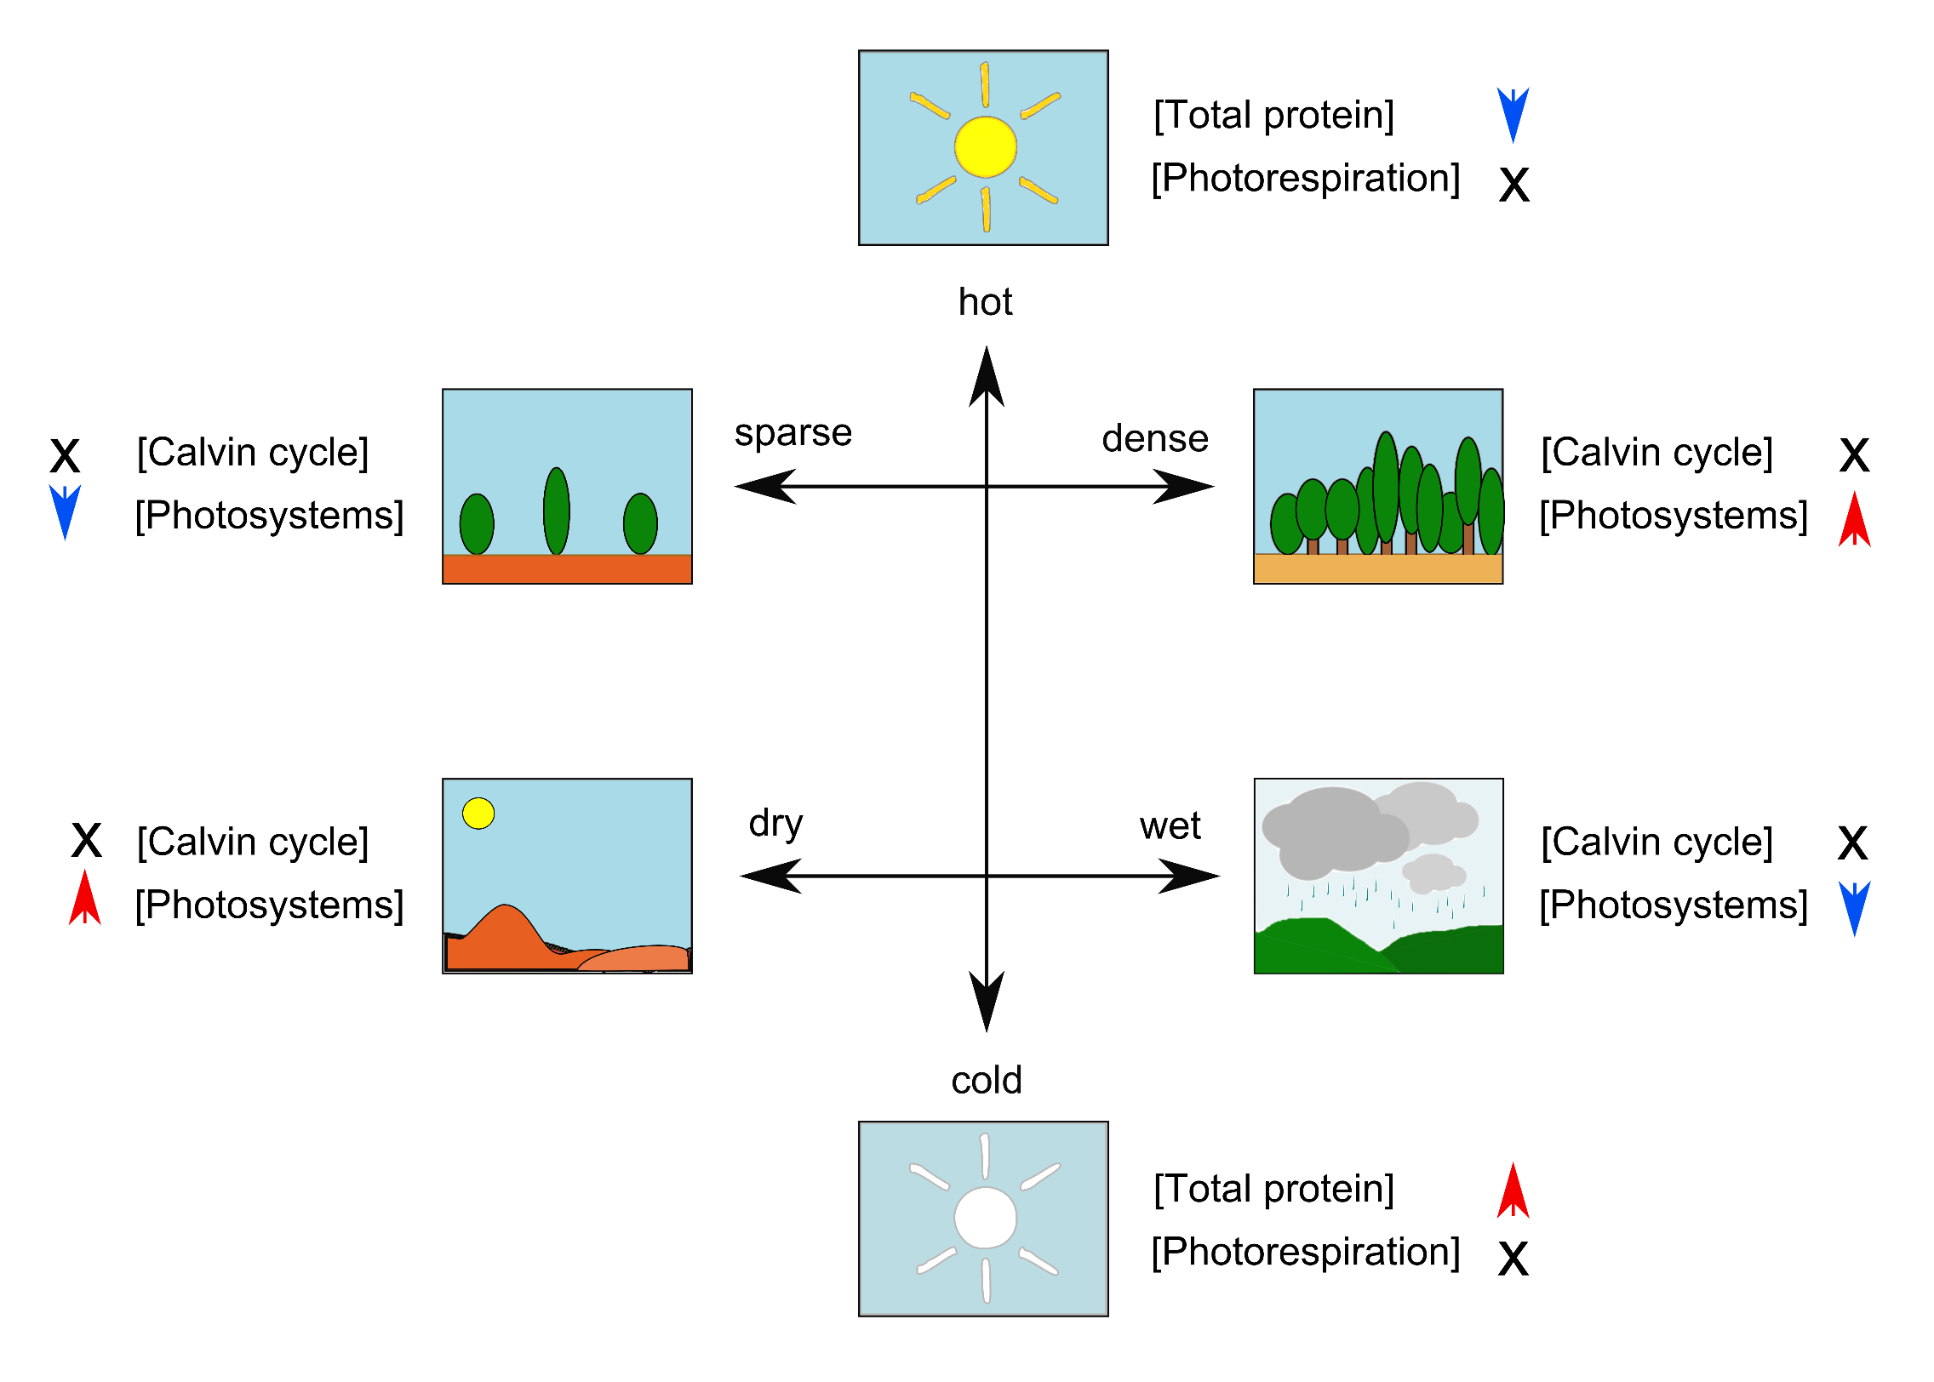
Actual trends

Slide 15
Summary
Proportional investment in photosystems optimised according to photons / area
Proportional abundance of Calvin cycle enzymes not especially variable – total abundance / leaf area matters more and is optimised anatomically by changing leaf thickness

Slide 16
Influence of leaf anatomy on protein abundance
Leaf mass per area (LMA) quantifies investment in leaves
Higher LMA leaves are better defended and live longer,
p < 0.001, R² = 0.31
Notes:
Leaf protein content is strongly determined by nitrogen content, as would be expected. Leaves which have a greater dry mass per area (i.e. thicker, denser leaves) tend to contain more protein, although this effect is variable.

Slide 17
LMA trends
p = 0.88
p < 0.001, R² = 0.26
p = 0.01, R² = 0.20
p = 0.15
Notes:
Leaves don’t produce more photosystem proteins as they become thicker, but they do produce more Calvin cycle proteins (and pretty much every other category of protein). Suggests that carboxylation capacity is added by leaf thickening but there is no effect on light capture.

Slide 18
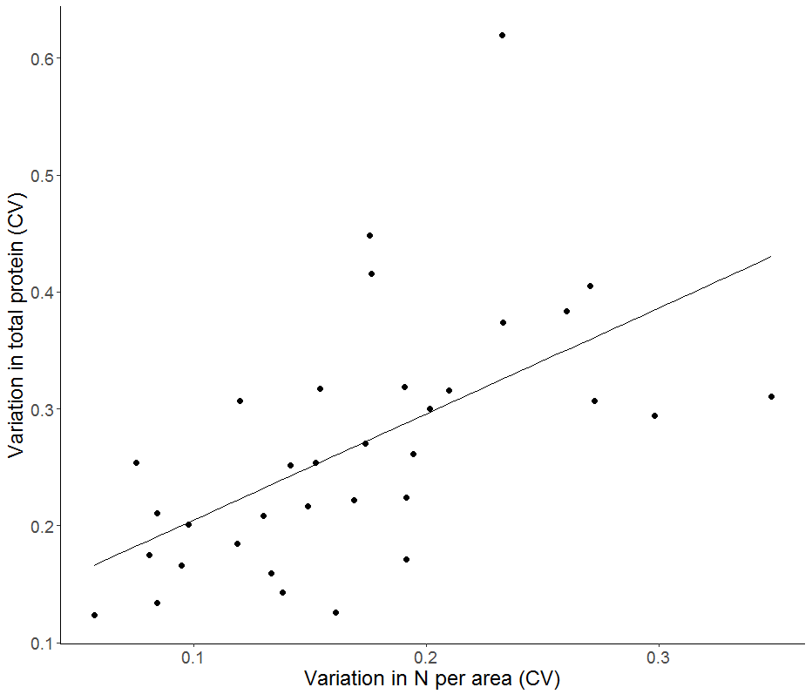

Slide 19
Environmental trends in leaf protein abundance
p = 0.66, R² = 0
p = 0.15, R² = 0.06
p = 0.03, R² = 0.13
p < 0.001, R² = 0.49

Slide 20
 | Canopy openness | Irradiance | Mean annual temp. | Mean annual precip.
Canopy openness | 1 | 0.85 | 0.2 | 0.55
Irradiance | 0.85 | 1 | 0.61 | -0.5
Mean annual temp. | 0.2 | 0.61 | 1 | 0.16
Mean annual precip. | -0.55 | -0.5 | 0.16 | 1
p < 0.001 R² = 0.32

